Slide 1
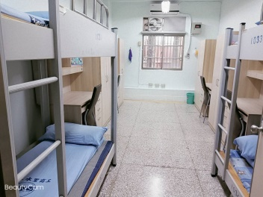
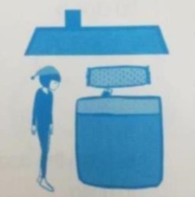
1.看到字型
2.想起圖片
3.引發口語詞彙
4.索引到目標字音
宿舍
宿
宿
宿舍
宿

